Slide 1
IP as the IoT Network Layer
Dr. Abbas Javed
Assistant Professor
Department of Electrical and Computer Engineering,
COMSATS University Islamabad, Lahore Campus
abbasjaved@cuilahore.edu.pk

Slide 2
Contents
The Business Case for IP: This section discusses the advantages of IP from an IoT perspective and introduces the concepts of adoption and adaptation.
The Need for Optimization: This section dives into the challenges of constrained nodes and devices when deploying IP. This section also looks at the migration from IPv4 to IPv6 and how it affects IoT networks.
Optimizing IP for IoT: This section explores the common protocols and technologies in IoT networks utilizing IP, including 6LoWPAN, 6TiSCH, and RPL.

Slide 3
Key Advantages of Internet Protocol
Open and standards-based
Versatile
Ubiquitous
Scalable
Manageable and highly secure
Stable and resilient
Consumers’ market adoption
The innovation factor

Slide 4
Adoption or Adaptation of the Internet Protocol
Adaptation means application layered gateways (ALGs) must be implemented to ensure the translation between non-IP and IP layers.
Adoption involves replacing all non-IP layers with their IP layer counterparts, simplifying the deployment model and operations.

Slide 5
Factors for determining the model
Bidirectional versus unidirectional data flow
Overhead for last-mile communications paths (require optimization)
Data flow model
Network diversity

Slide 6
The Need for Optimization
Constrained Nodes
“thing” architecture may or may not offer similar characteristics compared to generic PC or server in an IT environment
Unreliable communication path
Power consumption
Devices that are very constrained in resources, may communicate infrequently to transmit a few bytes, and may have limited security and management capabilities: This drives the need for the IP adaptation model, where nodes communicate through gateways and proxies.
Devices with enough power and capacities to implement a stripped-down IP stack or non-IP stack: In this case, you may implement either an optimized IP stack and directly communicate with application servers (adoption model) or go for an IP or non-IP stack and communicate through gateways and proxies (adaptation model).
Devices that are similar to generic PCs in terms of computing and power resources but have constrained networking capacities, such as bandwidth: These nodes usually implement a full IP stack (adoption model), but network design and application behaviors must cope with the bandwidth constraints.

Slide 7
The Need for Optimization
Constrained Networks
Constrained networks can have high latency and a high potential for packet loss.
Constrained networks are often referred to as low-power and lossy networks (LLNs). Lossy in this context refers to network unreliability that is caused by disruptions in the data flow or packet loss
Constrained networks are limited by low-power, low-bandwidth links (wireless and wired). They operate between a few kbps and a few hundred kbps and may utilize a star, mesh, or combined network topologies, ensuring proper operations
Packet delivery rate (PDR) Variation
Power Consumption

Slide 8
Factors for IPv4 and IPv6 Support
Application Protocol: IoT devices implementing Ethernet or Wi-Fi interfaces can communicate over both IPv4 and IPv6, but the application protocol may dictate the choice of the IP version. For example, SCADA protocols such as DNP3/IP (IEEE 1815), Modbus TCP, or the IEC 60870-5-104 standards are specified only for IPv4
Cellular Provider and Technology: For the first three generations of data services—GPRS, Edge, and 3G—IPv4 is the base protocol version. if IPv6 is used with these generations, it must be tunneled over IPv4. On 4G/LTE networks, data services can use IPv4 or IPv6 as a base protocol, depending on the provider
Serial Communications
IPv6 Adaptation Layer: newer technologies, such as IEEE 802.15.4 (Wireless Personal Area Network), IEEE 1901.2, and ITU G.9903 (Narrowband Power Line Communications) only have an IPv6 adaptation layer specified.

Slide 9
Optimizing IP for IoT
Constrained nodes and constrained networks mandate optimization at various layers and on multiple protocols of the IP architecture.

Slide 10
From 6LoWPAN to 6Lo
The initial focus of the 6LoWPAN working group was to optimize the transmission of IPv6 packets over constrained networks such as IEEE 802.15.4

Slide 11
The 6LoWPAN working group published several Request for comments (RFCs), but RFC 4994 is foundational because it defines frame headers for the capabilities of header compression, fragmentation, and mesh addressing.
These headers can be stacked in the adaptation layer to keep these concepts separate while enforcing a structured method for expressing each capability.

Slide 12
Header Compression
IPv6 header compression for 6LoWPAN was defined initially in RFC 4944 and subsequently updated by RFC 6282. This capability shrinks the size of IPv6’s 40-byte headers and User Datagram Protocol’s (UDP’s) 8-byte headers down as low as 6 bytes combined in some cases.
header compression for 6LoWPAN is only defined for an IPv6 header and not IPv4.
At a high level, 6LoWPAN works by taking advantage of shared information known by all nodes from their participation in the local network
it omits some standard header fields by assuming commonly used values

Slide 14
Fragmentation
The maximum transmission unit (MTU) for an IPv6 network must be at least 1280 bytes.
For IEEE 802.15.4, 127 bytes is the MTU.
You can see that this is a problem because IPv6, with a much larger MTU, is carried inside the 802.15.4 frame with a much smaller one.
To remedy this situation, large IPv6 packets must be fragmented across multiple 802.15.4 frames at Layer 2.

Slide 15
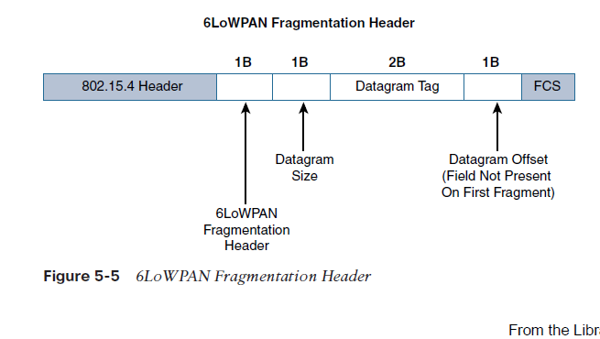

Slide 16
The fragment header utilized by 6LoWPAN is composed of three primary fields: Datagram Size, Datagram Tag, and Datagram Offset
The 1-byte Datagram Size field specifies the total size of the unfragmented payload.
Datagram Tag identifies the set of fragments for a payload.
Finally, the Datagram Offset field delineates how far into a payload a particular fragment occurs.

Slide 17
Mesh Addressing
The purpose of the 6LoWPAN mesh addressing function is to forward packets over multiple hops
Three fields are defined for this header: Hop Limit, Source Address, and Destination Address
Analogous to the IPv6 hop limit field, the hop limit for mesh addressing also provides an upper limit on how many times the frame can be forwarded
Each hop decrements this value by 1 as it is forwarded. Once the value hits 0, it is dropped and no longer forwarded.
The Source Address and Destination Address fields for mesh addressing are IEEE 802.15.4 addresses indicating the endpoints of an IP hop

Slide 18
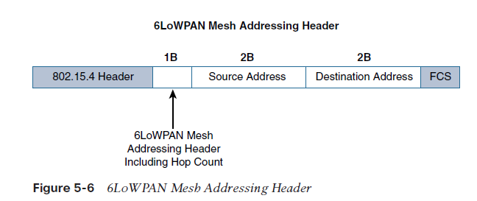

Slide 19
6LowPAN Packet
IEEE 802.15.4 DATA #74
From 0xABCD/00:12:74:02:00:02:02:02
to 0xABCD/00:12:74:06:00:06:06:06
Sec = false, Pend = false, ACK = true, iPAN = true,
DestAddr = Long, Vers. = 1, SrcAddr = Long
IPHC HC-06 TF = 3, NH = compressed, HLIM = 64, CID = 1,
SAC = stateful, SAM = 3, MCast = false, DAC = stateful, DAM = 3
Contexts: sci=0 dci=0
IPv6 TC = 0, FL = 0, ttl = 64
From aaaa:0000:0000:0000:0012:7402:0002:0202
to aaaa:0000:0000:0000:0012:7406:0006:0606
Frag Header nth size = 262, tag = 0x6304, offset = 0
Payload (17 bytes) (hex dump)
00 01 16 F0 22 3D 16 2E 5E 34 68 65 6C 6C 6F 20 37
ASCII (partial): ...^4hello 7

Slide 20
MAC layer (IEEE 802.15.4)
Frame source & destination:
PAN ID = 0xABCD (both endpoints use same PAN — a Personal Area Network).
Source MAC = 00:12:74:02:00:02:02:02 (64-bit long address).
Destination MAC = 00:12:74:06:00:06:06:06 (64-bit).
Flags:Sec = false → no 802.15.4 MAC security (no MAC-layer encryption/auth).
ACK = true → acknowledgements are enabled; sender expects an ACK from receiver.
iPAN = true → indicates an intra-PAN packet (PAN ID compression may be used).
DestAddr = Long and SrcAddr = Long → 64-bit addresses used (not short 16-bit).

Slide 21
6LoWPAN IPHC (IPv6 Header Compression)
TF = 3
Traffic Class & Flow Label compression indicator. TF=3 here means Traffic Class and Flow Label are elided (they are not carried in the packet) — the receiver must assume default values (TF = 0/0) when reconstructing IPv6 header.
NH = compressed
Next Header is compressed (i.e., a NHC — Next Header Compression — is used). This often means the next header is UDP (and UDP is compressed using LOWPAN_NHC_UDP) or another compressed protocol.
HLIM = 64
The Hop Limit (TTL) value for IPv6 packets is 64 (explicitly present or indicated).CID = 1A Context Identifier Extension is present — a 6LoWPAN context is in use. Contexts allow IPv6 prefixes to be replaced by a short ID to compress addresses.
SAC / DAC = stateful;
SAM / DAM = 3 These say that source/destination addressing uses stateful (context-based) compression and the addressing mode value (SAM/DAM) = 3. In practice this means the full interface identifier (IID) is derived from the link-layer address or from a context, not carried as 128-bit inline address. (In your packet the decompressed IPv6 addresses are shown, so the receiver used MAC/context info to reconstruct them.)

Slide 22
Reconstructed IPv6 addresses
The packet lists the reconstructed IPv6 addresses:
Source IPv6: aaaa:0000:0000:0000:0012:7402:0002:0202
Destination IPv6: aaaa:0000:0000:0000:0012:7406:0006:0606
The low 64 bits of the IPv6 addresses (the Interface Identifier / IID) match the source/dest 64-bit MACs shown at MAC-layer (the 0012:7402:0002:0202 part looks like the 64-bit MAC mapped directly as IID). Thus the compressor elided the IPv6 IID and the receiver reconstructed it from the MAC or context.

Slide 23
Fragmentation header
Frag Header nth size = 262, tag = 0x6304, offset = 0
This is a 6LoWPAN fragmentation header.
size = 262 → the full IPv6 datagram length (262 bytes) before fragmentation.
tag = 0x6304 → a tag to group fragments belonging to the same IPv6 datagram.
offset = 0 → this is the first fragment (offset zero).
The actual payload here is only 17 bytes because this is the first fragment; other fragments (if present) will contain the rest of the 262-byte IPv6 datagram.

